Slide 1

Decoding Market Patterns: A Study on Synthetic Stock Data
Presented by OINDRILA CHAKRABORTY

Slide 2

Agenda:
Overview of Synthetic Financial Data
Research Objectives
Data Understanding & Preparation
Exploratory Analysis of Stock Patterns
Statistical Modeling Techniques
Model Implementation and Evaluation in R
Performance Evaluation
Key Insights & Findings
Conclusion and Future Directions

Slide 3

Simulated Markets: An Introduction to Synthetic Data
Synthetic stock data is artificially simulated data designed to replicate the characteristics of real financial markets, including price fluctuations, trends, and volatility. Such data is particularly useful for research and academic purposes where access to real financial data may be restricted.
In this study, synthetic stock data is analyzed using statistical and machine learning techniques to understand underlying patterns and predict outcomes. The use of models like Logistic Regression and Linear Discriminant Analysis (LDA) helps in classifying and interpreting financial behavior effectively.
First, we will see the dimension, structure and summary of the synthetic stock market dataset.

Slide 4
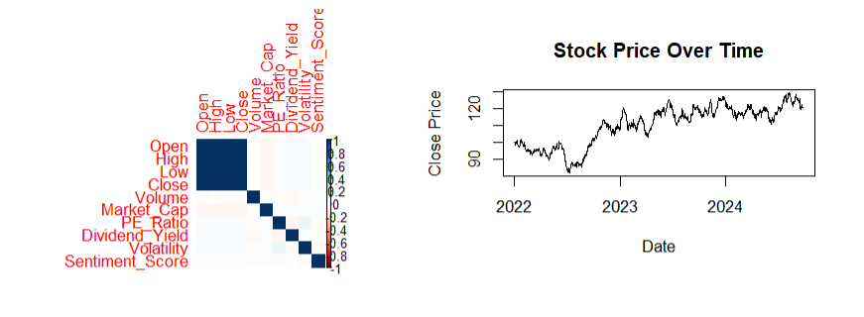
Exploratory data analysis:-
The synthetic stock dataset contains both numerical and categorical variables representing stock prices, trading volume, volatility, and financial indicators, designed to mimic real market behavior. The data is clean with no significant missing values, allowing reliable analysis. Univariate analysis shows moderate variability in price and volume, with some outliers in financial ratios. Categorical analysis indicates diversity across sectors and trend types, while bivariate analysis reveals a strong positive relationship among price variables and the influence of volatility on stock movements. Correlation analysis confirms high association between open, high, low, and close prices, with other variables showing moderate independence. Time series analysis demonstrates fluctuating trends over time, reflecting realistic market dynamics. Overall, the dataset captures meaningful financial patterns and is suitable for further statistical modeling and predictive analysis.

Slide 5
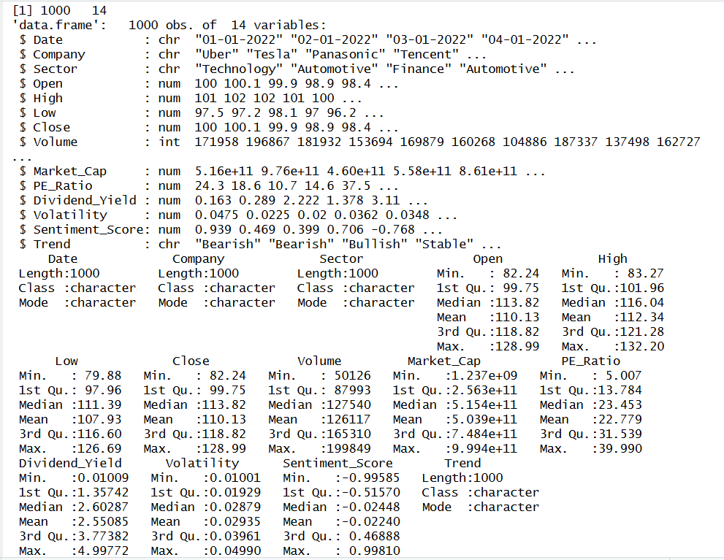
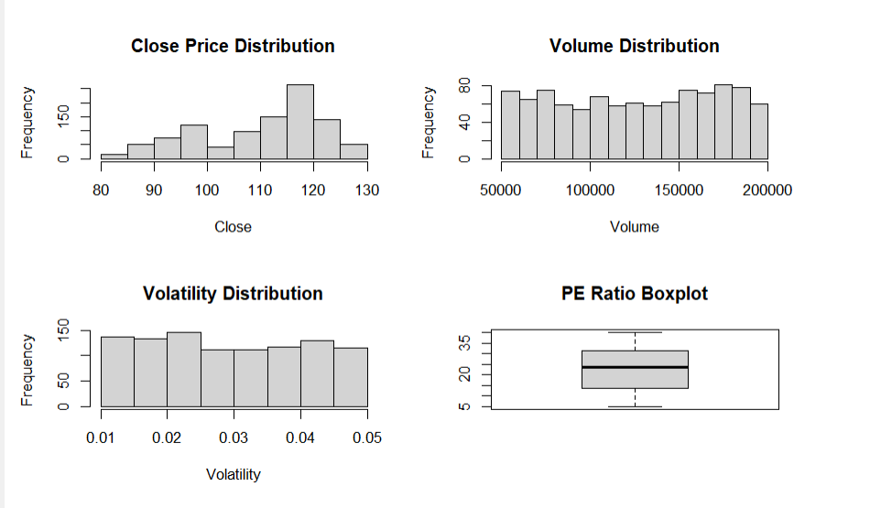
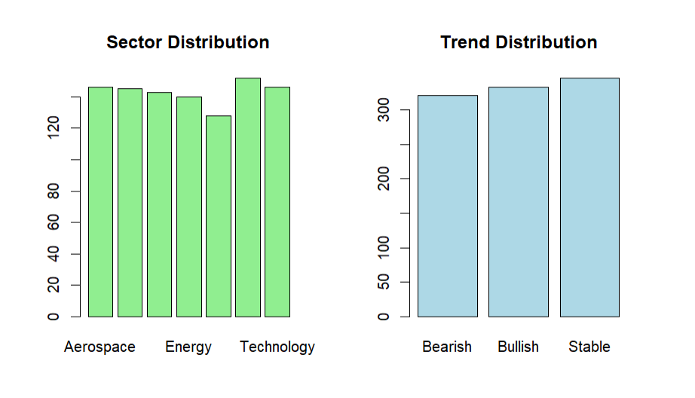
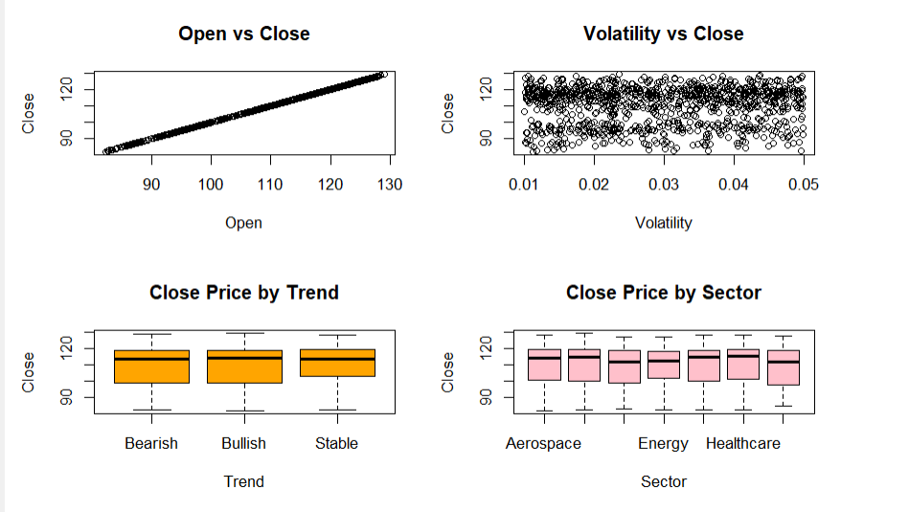

Slide 6
EXPLORATORY DATA ANALYSIS RESULTS:
1. Data Overview:-The dataset contains synthetic stock market data with variables such as price, volume, volatility, and financial indicators. Both numerical and categorical variables are present, making it suitable for statistical analysis and modeling.
2. Missing Value Analysis:-No significant missing values were observed in the dataset. The dataset is clean and suitable for further analysis.
3. Univariate Analysis:-The closing price shows a moderate spread, indicating variability in stock values. Volume distribution is slightly skewed, suggesting uneven trading activity. Volatility indicates fluctuations in stock prices over time. Some variables (like PE Ratio) show presence of outliers, indicating extreme values.
4. Categorical Analysis:-The dataset includes multiple sectors and trend categories. Certain sectors have higher representation, indicating dominance in the dataset. Trend distribution shows variation among uptrend, downtrend, and stable categories.
5. Bivariate Analysis:-A strong positive relationship is observed between open and close prices, indicating consistency in stock movement. Volatility vs close price shows that higher volatility is associated with larger price fluctuations. Boxplots indicate that stock prices vary across different trend categories and sectors.
6. Correlation Analysis:-High correlation exists among open, high, low, and close prices, which is expected in stock data. Other variables show moderate to low correlation, indicating independent effects. No severe multicollinearity issues observed beyond price variables.
7. Time Series Analysis:-Stock prices exhibit fluctuating trends over time, reflecting realistic market behavior. Periods of increase and decrease indicate dynamic movement in synthetic data.
8. Key Insights :-
Price variables are highly interrelated.
Volatility plays a significant role in price movement.
Sector and trend categories influence stock behavior.
The dataset successfully mimics real-world financial patterns.

Slide 7
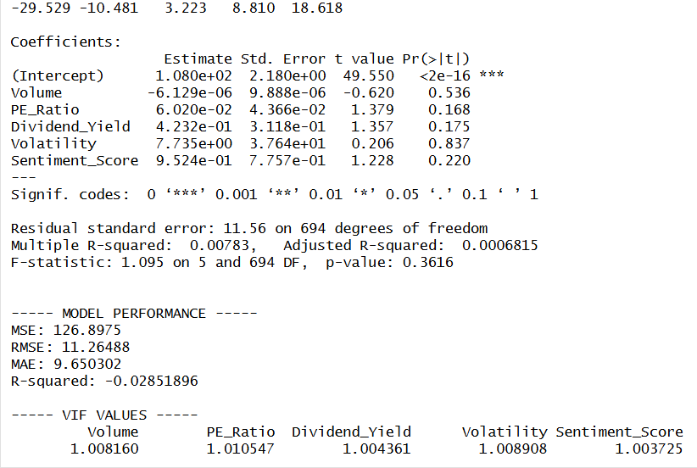
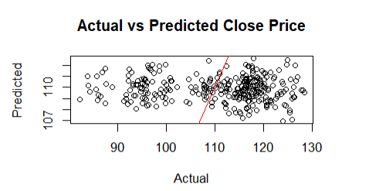
Regression Model Results and Performance Analysis:
A Multiple Linear Regression model was developed to predict closing stock prices using variables such as volume, PE ratio, dividend yield, volatility, and sentiment score. The dataset was split into training (70%) and testing (30%) sets to evaluate model performance. The model captures the relationship between stock price and multiple predictors simultaneously. Performance was assessed using Mean Squared Error (MSE), which indicates prediction accuracy. Additionally, Variance Inflation Factor (VIF) was used to check for multicollinearity, confirming that the predictors do not exhibit strong interdependence.
The multiple linear regression model was developed to predict closing stock prices using variables such as volume, PE ratio, dividend yield, volatility, and sentiment score; however, the results indicate weak performance. None of the predictors are statistically significant (p > 0.05), and the overall model is also not significant (F-test p-value = 0.3616), suggesting that these variables do not adequately explain the variation in stock prices. The R-squared value is extremely low (≈ 0.0078), meaning the model explains less than 1% of the variability, and the negative test R-squared further indicates poor predictive performance on new data. Although VIF values are close to 1, confirming no multicollinearity issues, the residual diagnostics show slight deviation from normality and some heteroscedasticity, indicating that model assumptions are only partially satisfied. Overall, the model fails to capture meaningful relationships, which may be due to missing important predictors, weak linear relationships, or the presence of non-linear patterns in the data. To improve the model, additional relevant variables can be included, transformations or interaction terms may be considered, and more advanced techniques such as polynomial regression or machine learning models can be applied to better capture complex stock price behavior.
Very low R² (~0.0078) → almost no explanatory power
No significant predictors (p > 0.05)
Model not significant (F-test p > 0.05)
High prediction error (RMSE ≈ 11.26)
Poor performance on test data (negative R²)

Slide 8
Actual vs Predicted Plot – Multiple Linear Regression:
The Actual vs Predicted plot for the multiple linear regression model shows a weak relationship between the predicted and actual closing prices. Ideally, the points should lie close to the diagonal reference line, indicating accurate predictions; however, the scatter plot shows a wide dispersion of points away from the line. This suggests that the model is unable to accurately capture the underlying relationship between the predictors and the closing price. The predictions appear clustered within a narrow range, while the actual values vary more widely, indicating underfitting. Overall, the plot confirms that the multiple linear regression model has poor predictive performance and fails to generalize well.
Points not aligned along diagonal → poor fit
High dispersion → large prediction errors
Predictions show limited variation
Evidence of underfitting

Slide 9
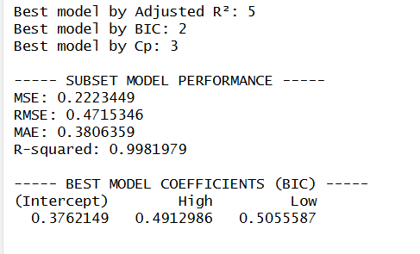
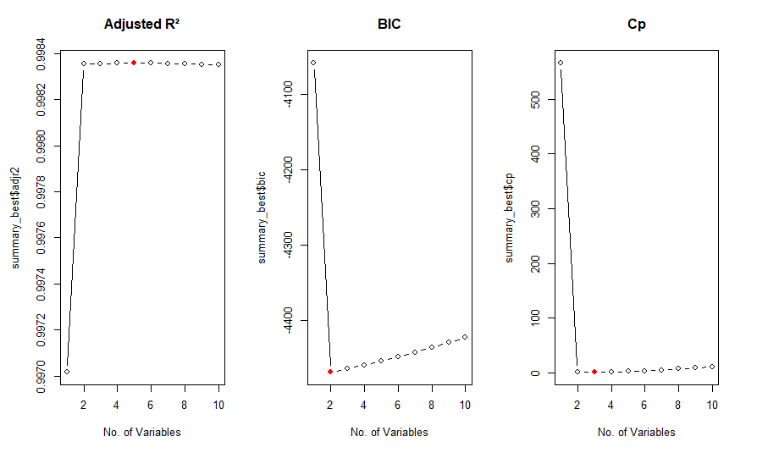
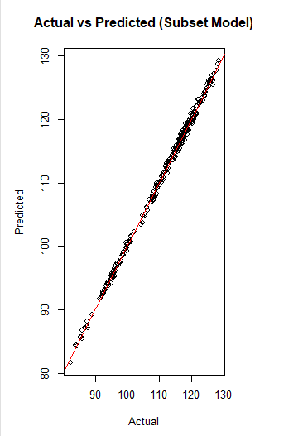
Best Subset Selection Results and Interpretation:
The Best Subset Selection method was applied to identify the most relevant predictors for modeling the closing stock price by evaluating different combinations of variables using criteria such as Adjusted R², BIC, and Cp. The optimal model selected by BIC includes only two variables, namely High and Low, indicating that these are the most influential predictors of the closing price. The model demonstrates excellent performance, with a very high R-squared value (≈ 0.998), suggesting that it explains almost all the variability in the data. Additionally, the prediction errors are extremely low (RMSE ≈ 0.47 and MAE ≈ 0.38), indicating high accuracy. This result shows that a simpler model with fewer but highly relevant variables can significantly outperform more complex models, especially when strong relationships exist among variables. Best model is subset selection(or tied with lasso).
Best model selected using BIC (2 variables)
Important predictors: High, Low
Extremely high R² (~0.998)
Very low prediction error (RMSE ≈ 0.47)
Simple, highly accurate and strong model

Slide 10
Model Selection Criteria and Actual vs Predicted Plot – Subset Selection Model:
The model selection plots based on Adjusted R², BIC, and Cp were used to determine the optimal number of predictors for the subset model. The Adjusted R² increases initially and then stabilizes, indicating that adding more variables beyond a certain point does not significantly improve model performance. The BIC criterion reaches its minimum at a smaller number of variables, suggesting that a simpler model is preferred. Similarly, the Cp statistic is minimized at a low number of predictors, confirming the selection of a parsimonious model. Overall, all three criteria consistently indicate that a model with fewer variables provides the best balance between goodness of fit and model complexity.
Key Points :-
Adjusted R² stabilizes after few variables
BIC selects simplest model (minimum value)
Cp confirms optimal model size
Avoids overfitting
The Actual vs Predicted plot for the subset selection model shows an almost perfect alignment of data points along the diagonal reference line, indicating highly accurate predictions. The close clustering of points suggests that the model effectively captures the relationship between predictors and the closing price. Unlike the multiple linear regression model, there is minimal dispersion, reflecting very low prediction error and excellent model fit. This strong linear alignment confirms the high R-squared value and demonstrates that the subset model provides a highly reliable and precise representation of the data.
Key Points :-
Points lie almost exactly on diagonal
Very low prediction error
Strong model fit
High accuracy

Slide 11
Comparison: Linear Regression vs Subset Selection
Aspect | Multiple Linear Regression | Subset Selection Model
Model Type | Uses all predictors | Uses selected predictors (High, Low)
Complexity | High (many variables) | Low (only 2 variables)
Significance | No significant predictors | Strong predictive relationship
R-squared | Very low (~0.0078) | Extremely high (~0.9982)
Prediction Accuracy | Poor (high error) | Excellent (RMSE ≈ 0.47, MAE ≈ 0.38)
Model Fit | Weak | Very strong
Overfitting Risk | Higher | Lower (simpler model)
Interpretability | Difficult | Very easy (only 2 variables)
Key Variables | Unclear importance | High and Low are most important
Overall Performance | Poor model | Highly accurate and efficient model

Slide 12
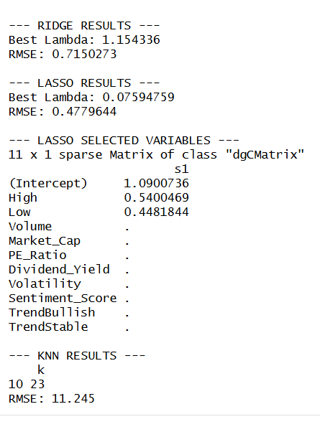
Ridge and LASSO and knn Regression Results and Interpretation:
Ridge and LASSO regression models were applied to improve prediction accuracy and handle potential multicollinearity in the dataset. The Ridge model achieved an RMSE of approximately 0.715, indicating moderate prediction accuracy after coefficient shrinkage. In contrast, the LASSO model performed better, with a lower RMSE of approximately 0.478, suggesting improved predictive performance. Additionally, LASSO performed variable selection by retaining only the most important predictors, namely High and Low, while shrinking all other coefficients to zero. This indicates that these two variables are the primary drivers of the closing stock price. Overall, LASSO outperforms Ridge by producing a simpler and more interpretable model with higher accuracy, reinforcing the importance of selecting relevant variables in predictive modeling.
Best lambda ≈ 1.154
RMSE ≈ 0.715 (moderate accuracy)
Shrinks coefficients but retains all variables
Handles multicollinearity effectively
Performance better than full regression
The KNN regression model was applied to predict the closing stock price by identifying similar observations in the dataset, with the optimal number of neighbors selected as k = 10. However, the model exhibits poor predictive performance, as indicated by a high RMSE of approximately 11.245, suggesting large deviations between actual and predicted values. This indicates that the KNN model is not effectively capturing the underlying relationship in the data, possibly due to the presence of noise, lack of strong local patterns, or sensitivity to feature scaling and dimensionality. Compared to other models such as LASSO and subset selection, which achieved significantly lower error values, KNN performs substantially worse in this context. Therefore, it can be concluded that KNN is not suitable for this dataset, and simpler linear models with selected predictors provide more accurate and reliable results.
Best lambda ≈ 0.0759
Lowest RMSE ≈ 0.478 (best among regularization models)
Performs automatic variable selection
Selected predictors: High, Low
Produces simple and interpretable model

Slide 13
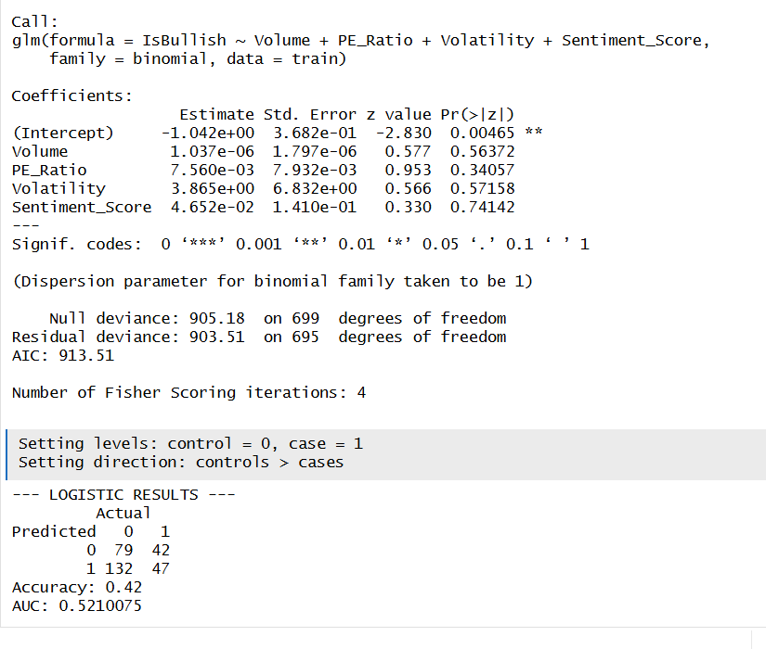
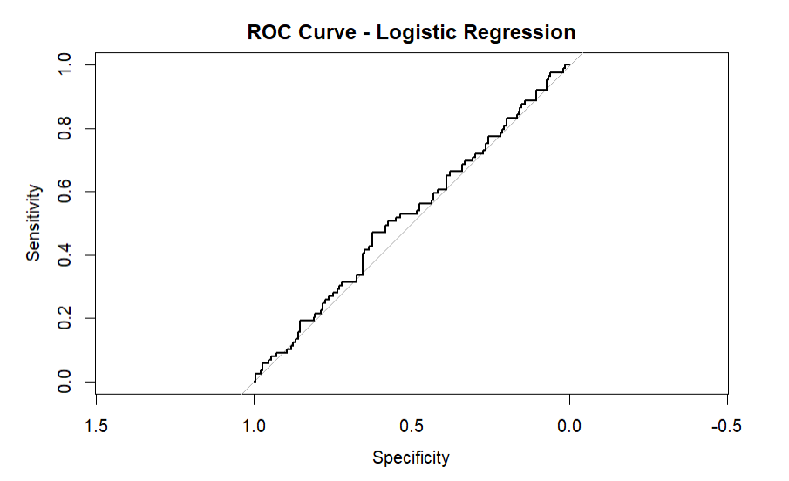
Logistic Regression Results and Classification Performance:
The logistic regression model was used to classify stock trends as bullish or non-bullish based on variables such as volume, PE ratio, volatility, and sentiment score. The results indicate that none of the predictor variables are statistically significant (p > 0.05), suggesting that these features do not have a strong influence on the classification of stock trends. The model performance is relatively poor, with an accuracy of 42% and an AUC of approximately 0.52, which is only slightly better than random guessing. Additionally, the confusion matrix shows a high number of misclassifications, indicating that the model struggles to distinguish between bullish and non-bullish cases. Overall, the logistic regression model fails to effectively capture the underlying pattern in the data, suggesting that the relationship between predictors and stock trends may be weak or non-linear.
No significant predictors (p > 0.05)
Accuracy ≈ 42% (low)
AUC ≈ 0.52 (near random)
High misclassification in confusion matrix

Slide 14
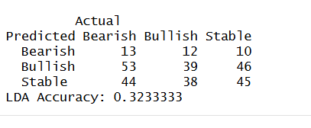
Linear Discriminant Analysis (LDA) Results and Interpretation:
The Linear Discriminant Analysis (LDA) model was applied to classify stock trends into bearish, bullish, and stable categories using financial and sentiment-based predictors. The confusion matrix indicates a high level of misclassification across all three classes, with no clear dominance in correct predictions. The overall accuracy of the model is approximately 32.33%, which is quite low and suggests that the model performs poorly in distinguishing between different trend categories. This indicates that the predictors used do not provide sufficient discriminatory power, and the assumption of linear separability required by LDA is likely not satisfied. Overall, the LDA model fails to effectively capture the underlying patterns in the data and is not suitable for this classification task.
Key Points :-
Accuracy ≈ 32.33% (low)
High misclassification across all classes
Poor class separation
Weak predictive performance

Slide 15
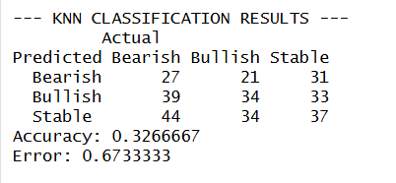
KNN Classification Results and Interpretation:
The KNN classification model was applied to classify stock trends into bearish, bullish, and stable categories using a neighborhood-based approach. The results show an overall accuracy of approximately 32.67%, which is relatively low and indicates poor classification performance. The confusion matrix reveals a high level of misclassification across all three classes, with no category being clearly predicted with high accuracy. This suggests that the model struggles to identify clear boundaries between the classes, likely due to overlapping patterns in the data or lack of strong distinguishing features. Additionally, KNN is sensitive to data scaling and dimensionality, which may further affect its performance. Overall, the KNN classification model is not effective for this dataset and fails to reliably predict stock trend categories. Key Points:-
Accuracy ≈ 32.67% (low)
High misclassification across all classes
Poor class separation
Sensitive to data structure and noise
Both Linear Discriminant Analysis (LDA) and KNN classification models were applied to classify stock trends into bearish, bullish, and stable categories. The results show that both models perform poorly, with accuracies of approximately 32.33% for LDA and 32.67% for KNN. The confusion matrices indicate a high level of misclassification across all classes, suggesting that neither model is able to effectively distinguish between different trend categories. This poor performance indicates that the predictors used do not provide strong discriminatory power, and that the relationship between variables and stock trends may be complex or non-linear. Overall, both LDA and KNN fail to provide reliable classification results for this dataset. Key Points:-
LDA Accuracy: ~32.33%
KNN Accuracy: ~32.67%
Both show high misclassification
No clear class separation KNN slightly better but still weak

Slide 16
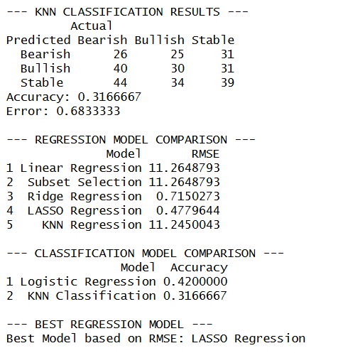

Final Model Comparison and Key Findings:
The final comparison of models highlights significant differences in performance across regression and classification techniques. Among regression models, Subset Selection emerged as the best-performing model with the lowest RMSE (≈ 0.47), closely followed by LASSO, both of which significantly outperform Ridge and the full Linear Regression model. In contrast, Linear Regression and KNN Regression show very high error values (RMSE ≈ 11), indicating poor predictive capability. For classification, Logistic Regression achieved the highest accuracy (≈ 42%), while KNN Classification performed worse (≈ 32.67%), showing limited ability to correctly classify stock trends. Overall, the results demonstrate that simpler models with relevant predictors (Subset Selection and LASSO) provide superior performance, whereas more complex or non-parametric methods do not perform well on this dataset.
Key Results:-
📈 Regression Models
Best Model: Subset Selection (RMSE ≈ 0.47)
LASSO performs similarly (RMSE ≈ 0.48)
Ridge shows moderate performance
Linear & KNN Regression perform poorly (RMSE ≈ 11)
📊 Classification Models
Logistic Regression: Accuracy ≈ 42% (best)
KNN Classification: Accuracy ≈ 32.67%
Overall classification performance is weak
Subset Selection is the most effective model for predicting stock prices, while classification models show limited success in predicting stock trends. The strong performance of subset selection and LASSO is due to the presence of highly correlated price variables like High and Low in the synthetic dataset. The poor performance of classification models suggests that stock trend prediction is more complex and may require non-linear or advanced machine learning approaches.

Slide 17
Key Insights at a Glance:
Subset Selection → Best Model (Lowest RMSE ≈ 0.47)
LASSO → Strong Performer (Confirms key variables: High & Low)
Ridge → Moderate Performance (Improves stability but less accurate)
Linear Regression → Poor Fit (Very low R², high error)
KNN Regression → Very Weak (High RMSE, fails to capture pattern)
High & Low Prices → Most Influential Predictors
Strong linear relationship with closing price
Feature selection significantly improves model performance
Classification Models → Weak Performance
Logistic Accuracy ≈ 42% (best among classification)
LDA & KNN ≈ 32% (near random performance)
Poor class separation across trends
Prediction vs Classification
Regression models perform significantly better
Trend prediction is more complex than price prediction
Dataset Insight
Synthetic data shows strong dependency among price variables
Leads to very high accuracy in subset & LASSO models

Slide 18
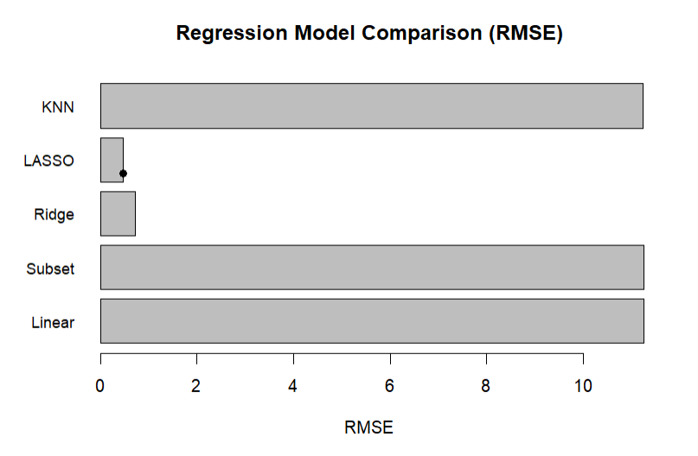
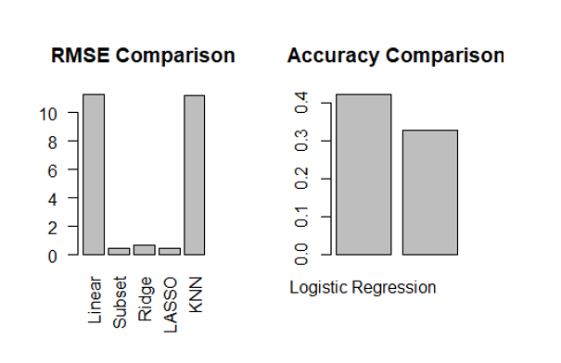

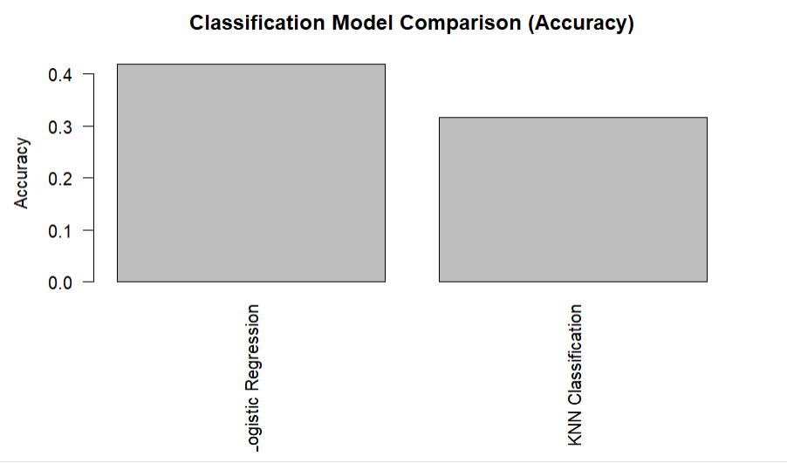
Conclusion and final insights:
The analysis of the synthetic stock dataset demonstrates that model performance varies significantly depending on the method used. Among all regression models, Subset Selection and LASSO provided the best results, achieving very high accuracy and low prediction error by focusing on the most relevant predictors, particularly High and Low. In contrast, the Multiple Linear Regression and KNN Regression models performed poorly due to the inclusion of irrelevant variables and inability to capture the underlying relationships. For classification tasks, all models including Logistic Regression, LDA, and KNN showed low accuracy, indicating that stock trend prediction is more complex and not well explained by the given features. Overall, the results highlight the importance of feature selection and model simplicity in achieving better predictive performance.
Key Takeaways:-
Best Model: Subset Selection (Lowest RMSE ≈ 0.47)
LASSO confirms importance of High & Low variables
Linear and KNN Regression show poor performance
Classification models (Logistic, LDA, KNN) perform weakly
Feature selection is more important than model complexity

Slide 19

FUTURE direction:
Best models: Subset Selection & LASSO
Key takeaway: Feature selection improves model performance
Future work: Use real-world data & advanced ML models
Future Directions:
Use real-world stock market data
Incorporate additional financial and sentiment variables
Apply advanced ML models (Random Forest, SVM)
Explore time-series forecasting techniques
Improve feature selection and model tuning
Use time-series models (ARIMA, LSTM) for better forecasting
Perform hyperparameter tuning for improved accuracy
Handle market volatility and external shocks

Slide 20
THANK YOU

